Slide 1

Impact of COVID-19 on the U.S. Economy
By: William Kim

Slide 2

Question of Interest
*COVID-19 continues to impact lives worldwide
*The country remains divided on whether is it advisable to return to normal life and fully reopen the economy or whether the threat of virus to the U.S. population outweighs the economic fallout

Slide 3
Goals
1. Analyze trends in COVID-19 statistics (positive cases, deaths, hospitalizations, and administered tests over the last 7 months)
2. Determine the effectiveness of the U.S. government’s efforts to respond to the virus
3. Compare the state and national real GDP(adjusted for inflation rates) and unemployment rates before and after the arrival of COVID-19 in the United States
4. Gain better perspective on how the current U.S. economy compares to other periods of economic hardship over the past 50-100 years(historical data)
* Real GDP and unemployment rate are two of the most important economic indicators

Slide 4
Downloaded Datasets
Dataset 1: “Excess_Deaths_Associated_with_COVID-19.csv”
Downloaded from the official CDC website
Provides a lower and higher estimate for deaths related to COVID-19 that are not part of the official recorded U.S. death toll for each state(All Causes vs. Except COVID-19)
Wanted to obtain a more accurate death toll to better understand the lethality of the virus
Dataset 2: “qgdpstate1020_0.xlsx”
Downloaded from the “U.S. Bureau of Economic Analysis” website
Provides the percent decrease in state RGDP during each quarter from 2019 Q1 to 2020 Q2
Compares the timing of pandemic to the decrease in each state’s overall productivity
Dataset 3: “UNRATE.csv”
Downloaded from the “Federal Reserve of St. Louis” website
Provides the national unemployment rate each month since 1948
Able to gain better perspective on how the national unemployment rate during COVID compares to other periods of economic hardship over the past 75 years
Dataset 4: “GDPC1.csv”
Downloaded from the “Federal Reserve of St. Louis” website
Provides the national RGDP(billions of 2012 U.S. dollars) each quarter since 1947
Able to gain better perspective on how the national RGDP during COVID compares to other periods of economic hardship over the past 75 years

Slide 5
Web Collected Datasets
Dataset 5: “NationalStats.xlsx” (Cleaned name)
Scraped using an API from the “COVID-19 Tracking Project”
Provides all relevant recorded statistics related to COVID-19 as of 11/08/2020
Dataset 6: “StateUR%LF.xlsx” (Cleaned name)
Scraped the HTML source code of the “National Conference of State Legislatures” website using BeautifulSoup from bs4
Provides the 2020 monthly state unemployment rates
Wanted to look at both national and state unemployment rates during the pandemic

Slide 6
Cleaning Process
Main Modules Utilized:
1. Pandas
-Converted and exported data to new excel files
-Uniformized data(float), accounted for empty cells
2. Numpy
- Accounted for NaN values
3. Requests
-API, HTML source code
4. Re
-Specifically parsed strings of data
5. Json
-Converted API request object into json format
6. BeautifulSoup from bs4
-Scraped the HTML source code
7. Pretty Print
-Allowed for better organization of return statements

Slide 7
Inconsistencies
*Replaced all NaN values and empty cells with “N/A”
*Converted all elements to floats before exporting to excel file(.astype(float))
*Removed all commas(.replace())
Dataset 5 contained a large outlier on 2020-02-27. From 2020-02-26 to 2020-02-27 the total number of tests increased from 16 to 6462. In addition, in the same period, the number of deaths when up by 2 from 0 even though there were no positive tests or many tests at all up until this date. I removed all days prior to 2020-02-27.
In dataset 6, the unemployment rate for Alaska in February had a different set of subtags than the rest of the table. I handled this by checking for a different pattern using re.search() and .group(), and then appended the value at the proper index for list of stats for Alaska.
For my second downloaded dataset, the original formatting of the headers of the xlsx file caused each header of the loaded data frame to be unnamed. I handled this by reassigning each header to a new name and deleted the beginning rows that caused the formatting issue.

Slide 8
Insights
1. {229238: (402127, 433614), '2.35%': ('4.05%', '4.35%')}
-Keys represents the values for the national recorded death toll and death rates
-Values represent the lower and higher estimates for the actual national death toll and death rates
2. [(‘42.99%', '47.13%'), ('1.74%', '2.051%’)]
-1st tuple represents the lower and upper range for the percent error for any given recorded national total number of deaths released by the U.S. government
-2nd tuple represents the lower and upper range for the percent error for any given recorded national total number of positive cases released by the U.S. government
3. Returns a pandas data frame
-3rd column (“Test per Positive Case”) holds a float representing the proportion of number of tests per positive case for each day
4. {'2020-04-01': ('$1708.34B', '31.31%’)}
-Represents the largest numeric/% decrease in national RGDP from one quarter to the next since 1947
5. {'2020-04-01': 14.7, '2020-05-01': 13.3, '2020-06-01': 11.1}
-Represents the top 3 months with the highest national unemployment since 1948(keys) and the corresponding unemployment rates(values)

Slide 9
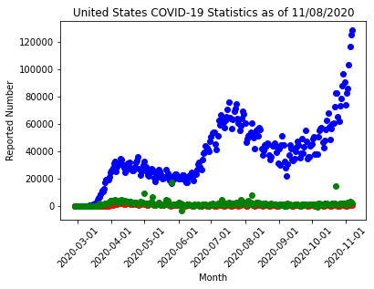
Visualization 1
Blue: “# of Positive Cases per Day”
Red: “# of Deaths per Day”
Green: “# of Hospitalizations per Day”

Slide 10
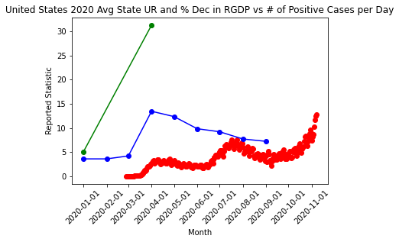
Visualization 2
Red: “# of Positive Cases per Day(In tens of thousands of cases)”
Blue: “Avg State UR”
Green: “Avg State % Dec in RGDP”

Slide 11
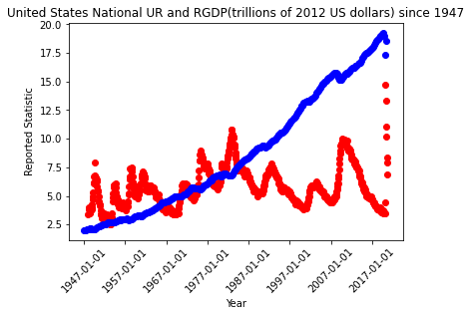
Visualization 3
Red: “National UR”
Blue: “RDGP(Trillions of $)”

Slide 12
Summary Files
1. Data frame from insight 3 exported to a new excel file
2. Contains only the columns used in Insight 1 from “ExcessDeaths.xlsx” for each state
- “Lower Estimate for All Causes”
- “Higher Estimate for All Causes”
- “Lower Estimate for Except COVID”
- “Higher Estimate for Except COVID”
- “Lower Estimate for Excess COVID”
- “Higher Estimate for Excess COVID”

Slide 13
Conclusion
*In conclusion, because the death rate, infection rate, and hospitalization rate of COVID-19 has remained static, I can conclude that the virus has not mutated. In addition, due to the proportion of number of tests administered per positive case each day, I can say that the U.S. federal and local governments are doing an adequate job in responding to the pandemic. However, because the death rate is being largely under reported and the number of cases are continuing to exponentially rise, I suggest that state governments do more to enforce the wearing of masks and social distancing as both are still much needed. In conjunction with these precautions, local governments also need to begin reopening the economy, as COVID-19 has resulted in the largest decrease in productivity (RGDP) in almost the last 75 years with more than 10% of the civilian work force unemployed for the last 7 months.

Slide 14
Sources
Downloaded Dataset Sources:
1. https://data.cdc.gov/NCHS/Excess-Deaths-Associated-with-COVID-19/xkkf-xrst
2. https://www.bea.gov/data/gdp/gdp-state
3. https://fred.stlouisfed.org/series/UNRATE
4. https://fred.stlouisfed.org/series/GDPC1
Web Collected Sources:
1. https://covidtracking.com/data/national ,API: https://api.covidtracking.com/v1/us/daily.json
2. Source: https://www.ncsl.org/research/labor-and-employment/state-unemployment-update.aspx
Additional Source:
https://www.thetimesusa.com/2020/04/05/a-state-by-state-overview-of-the-coronavirus-lockdown/

